Slide 1

伝搬「でんぱん」：波動が伝わり広がっていくこと
A reactive motion planner is one that takes in local information from the robot’s surroundings in order to generate a trajectory that is collision-free and makes progress towards some goal location.

Slide 2
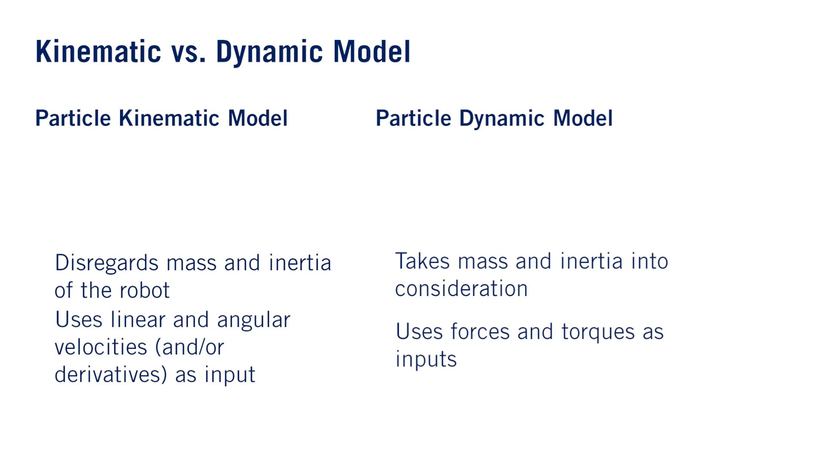
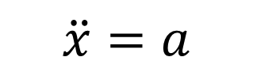
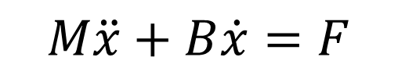
粒子「りゅうし」
$$\ddot{x}=a$$
$$M\ddot{x}+B\dot{x}=F$$
•
•
•
•
For path planning and trajectory optimization, often focus on kinematic models to make the motion planning problem more computationally tractable and leave the issues raised by the simplification of the dynamics to the controller.

Slide 3
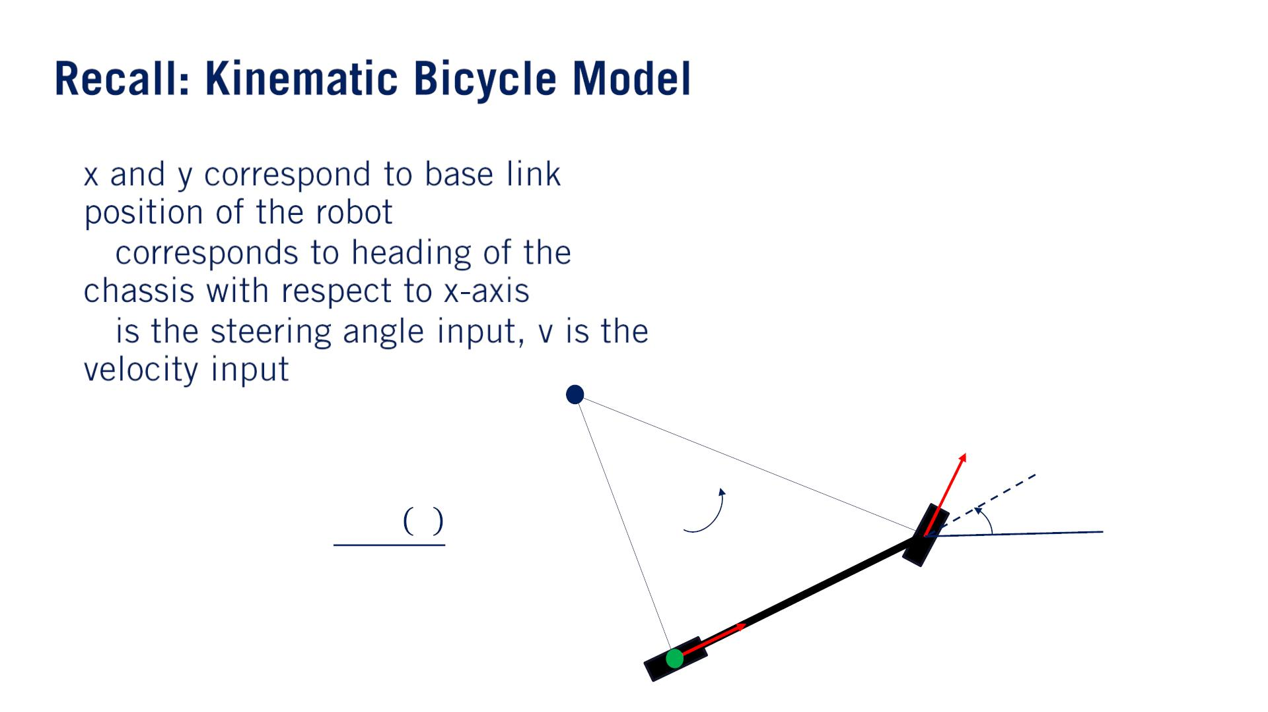
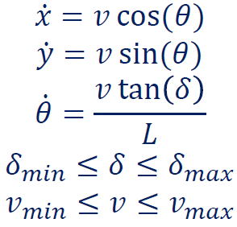
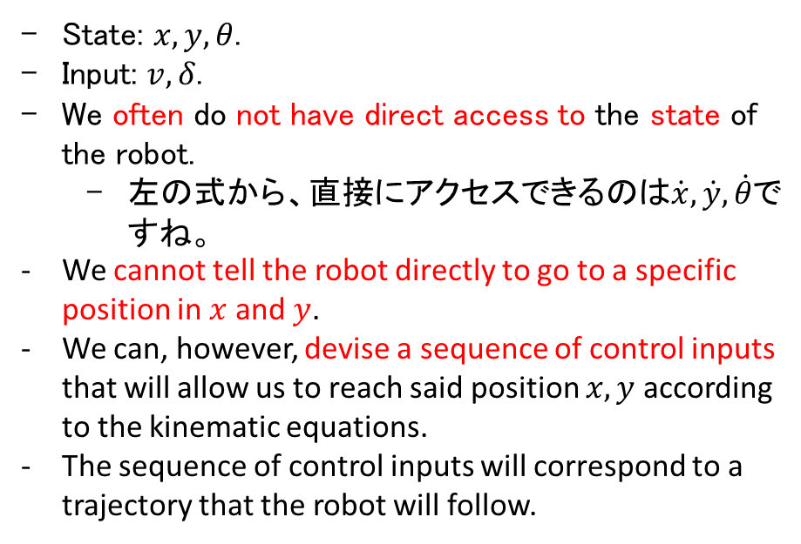
State: $x, y, θ$.
Input: $v, δ$.
We often do not have direct access to the state of the robot.
左の式から、直接にアクセスできるのは$\dot{x}, \dot{y}, \dot{θ}$ですね。
We cannot tell the robot directly to go to a specific position in $x$ and $y$.
We can, however, devise a sequence of control inputs that will allow us to reach said position $x, y$ according to the kinematic equations.
The sequence of control inputs will correspond to a trajectory that the robot will follow.
•
• 휃
• 훿
車台
ICR
훿
푣
훿
푅
휔
휃
푣
퐿

Slide 4
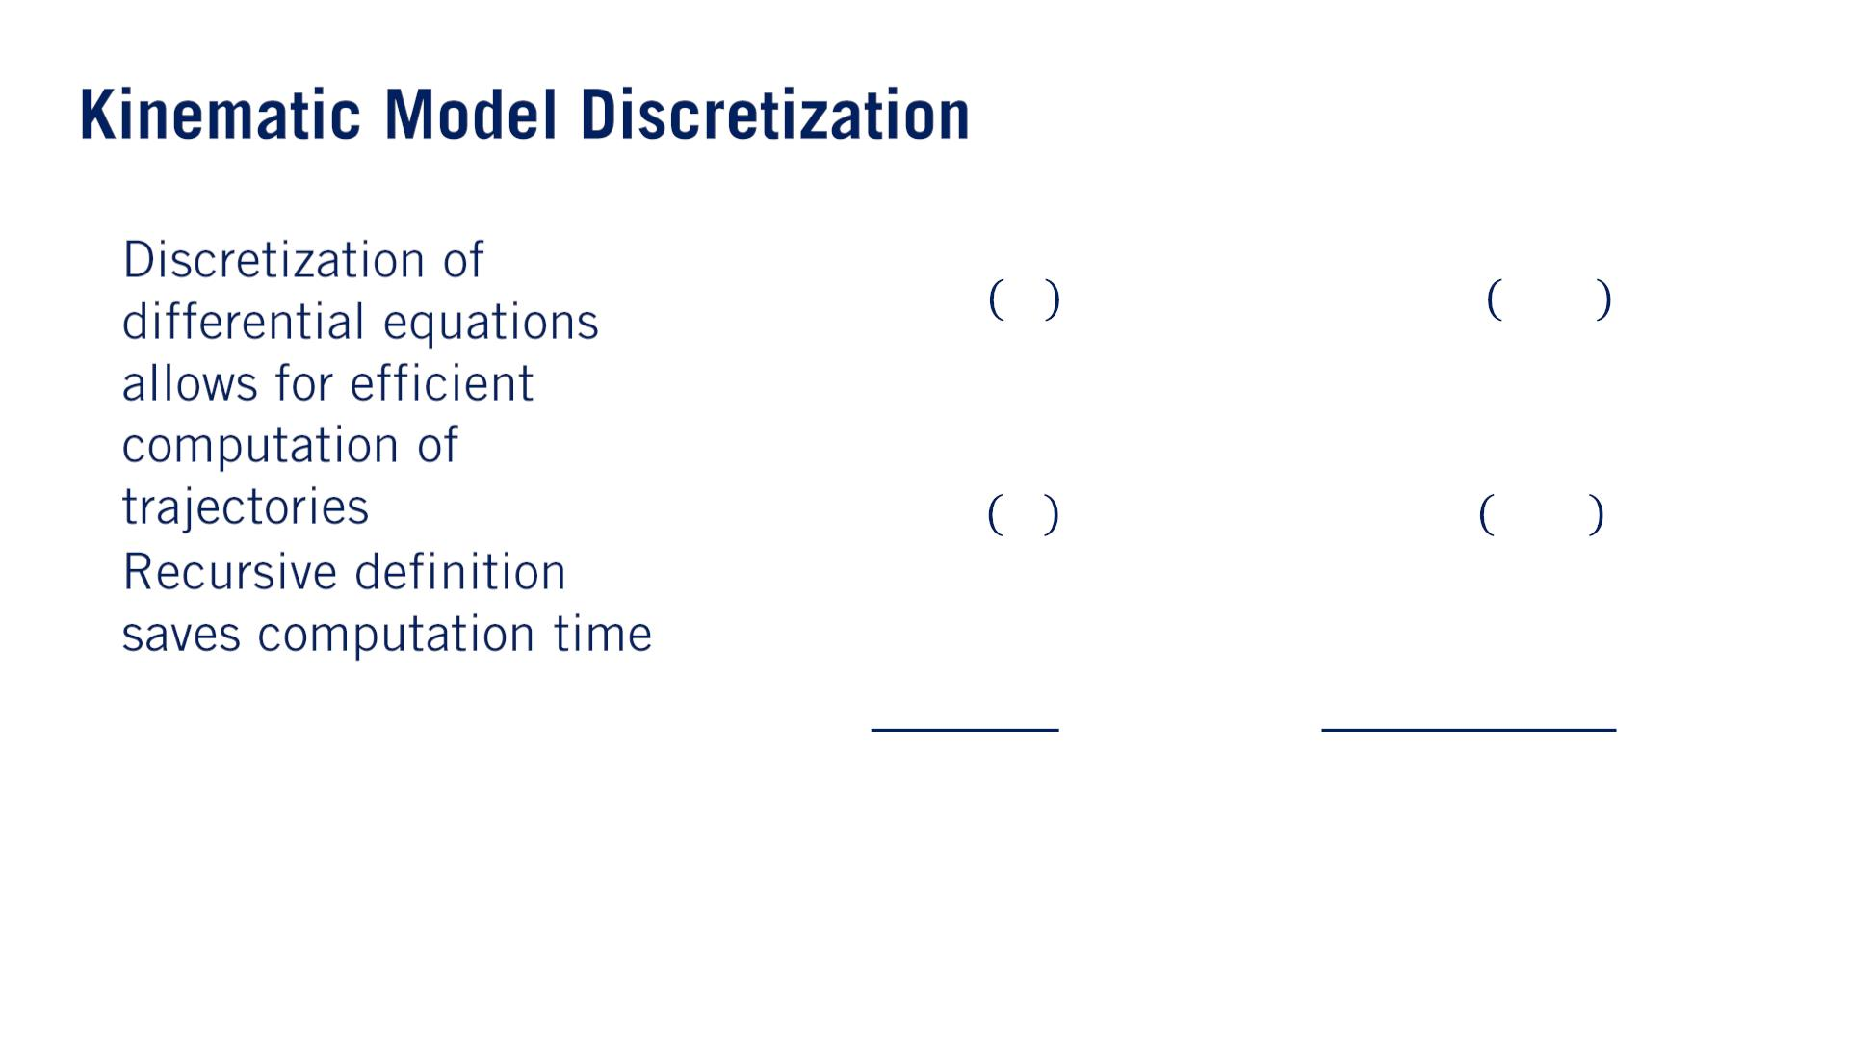
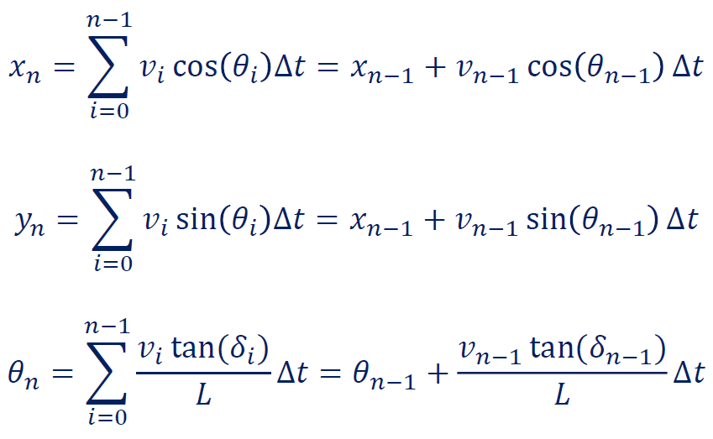
•
•
一定のsteer angle, velocityで軌道を伸ばす（trajectory propagationの意味）

Slide 5
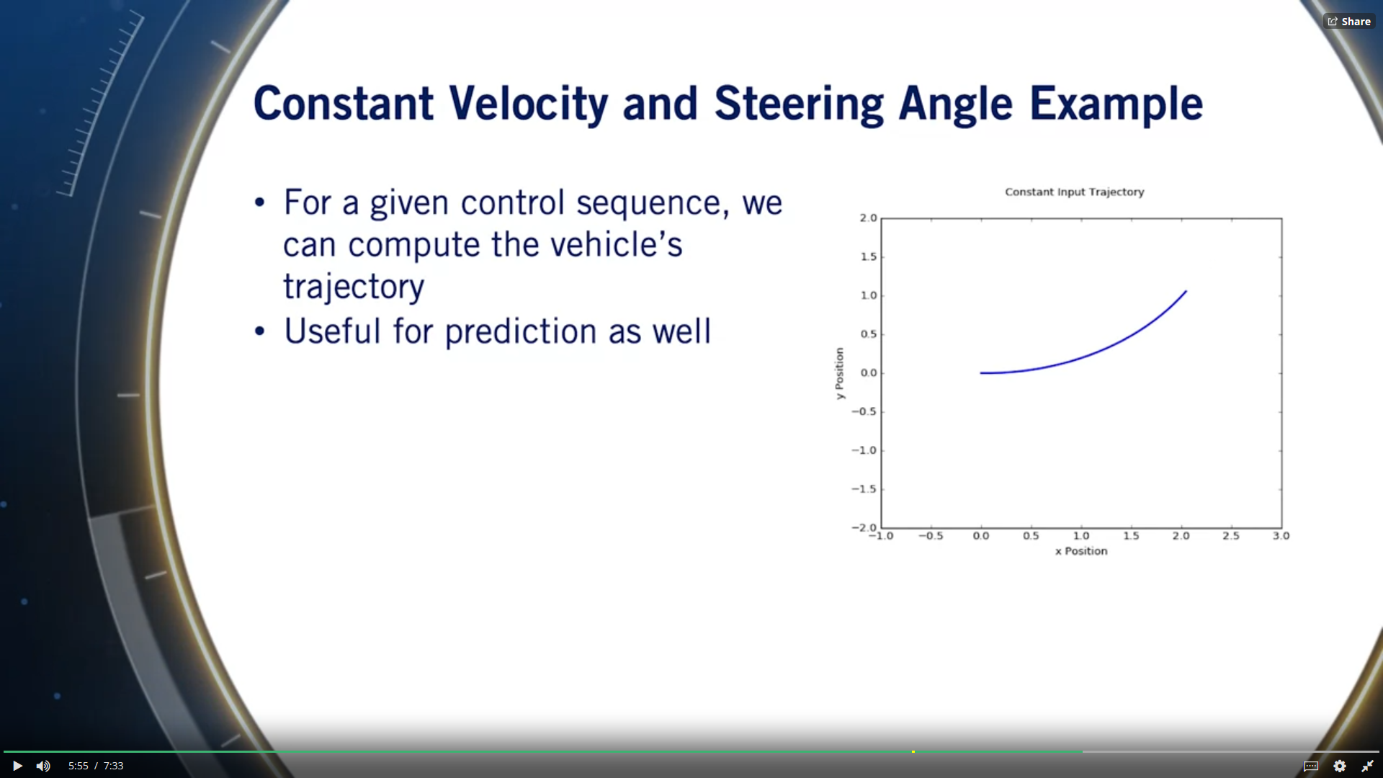
Also useful for prediction, where we know a kinematic model of a different agent in the driving scenario and we have an educated guess on the control inputs they will take.

Slide 6
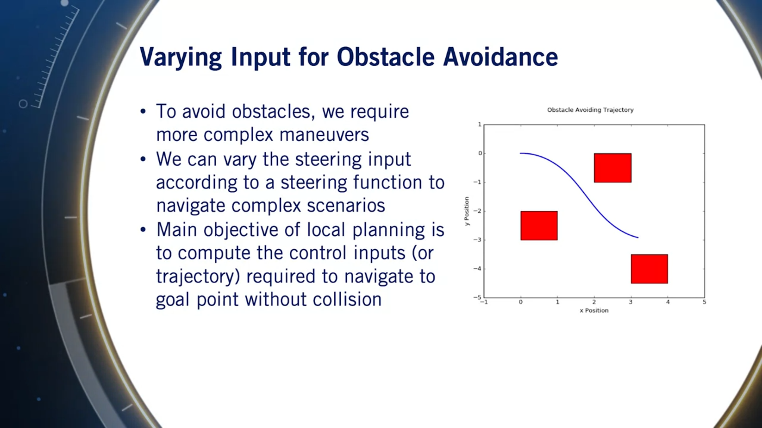

Slide 7
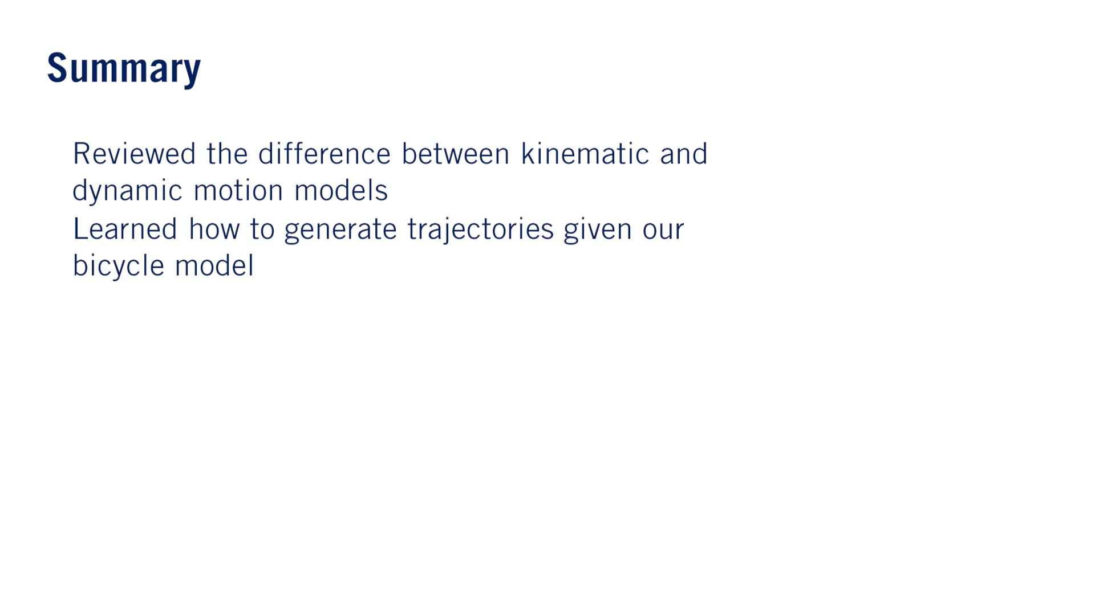
•
•

Slide 8


Slide 9
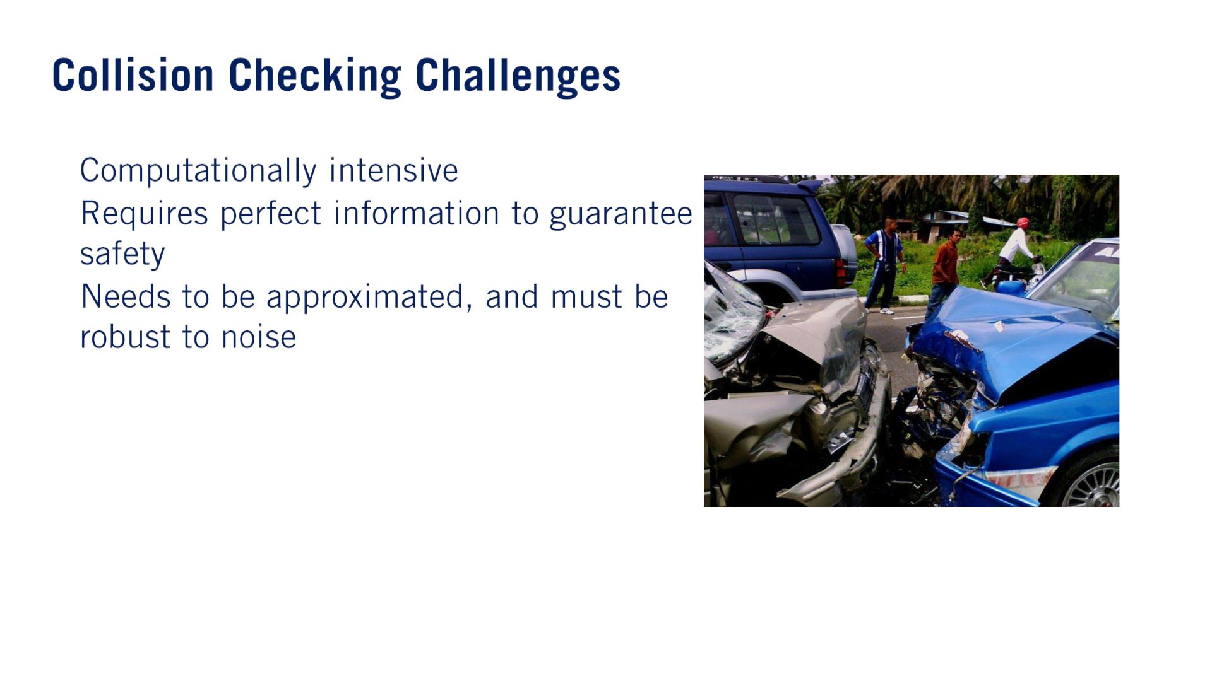
•
•
Especially for complex shapes and detailed environments.
•
The information given to us by the occupancy grid is an imperfect estimate, which means that we need to add buffers to our collision checking algorithms to make them more error tolerant.

Slide 10
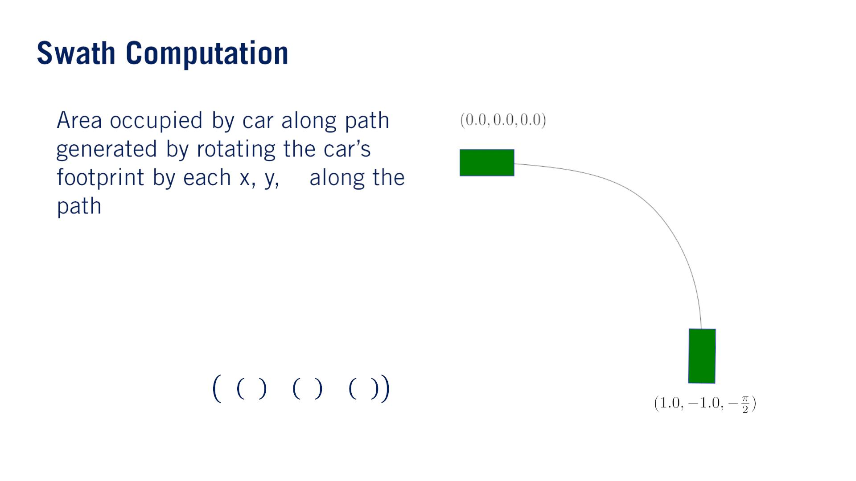
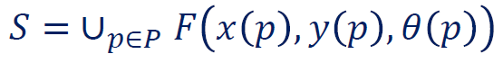
帯状
•
휃

Slide 11
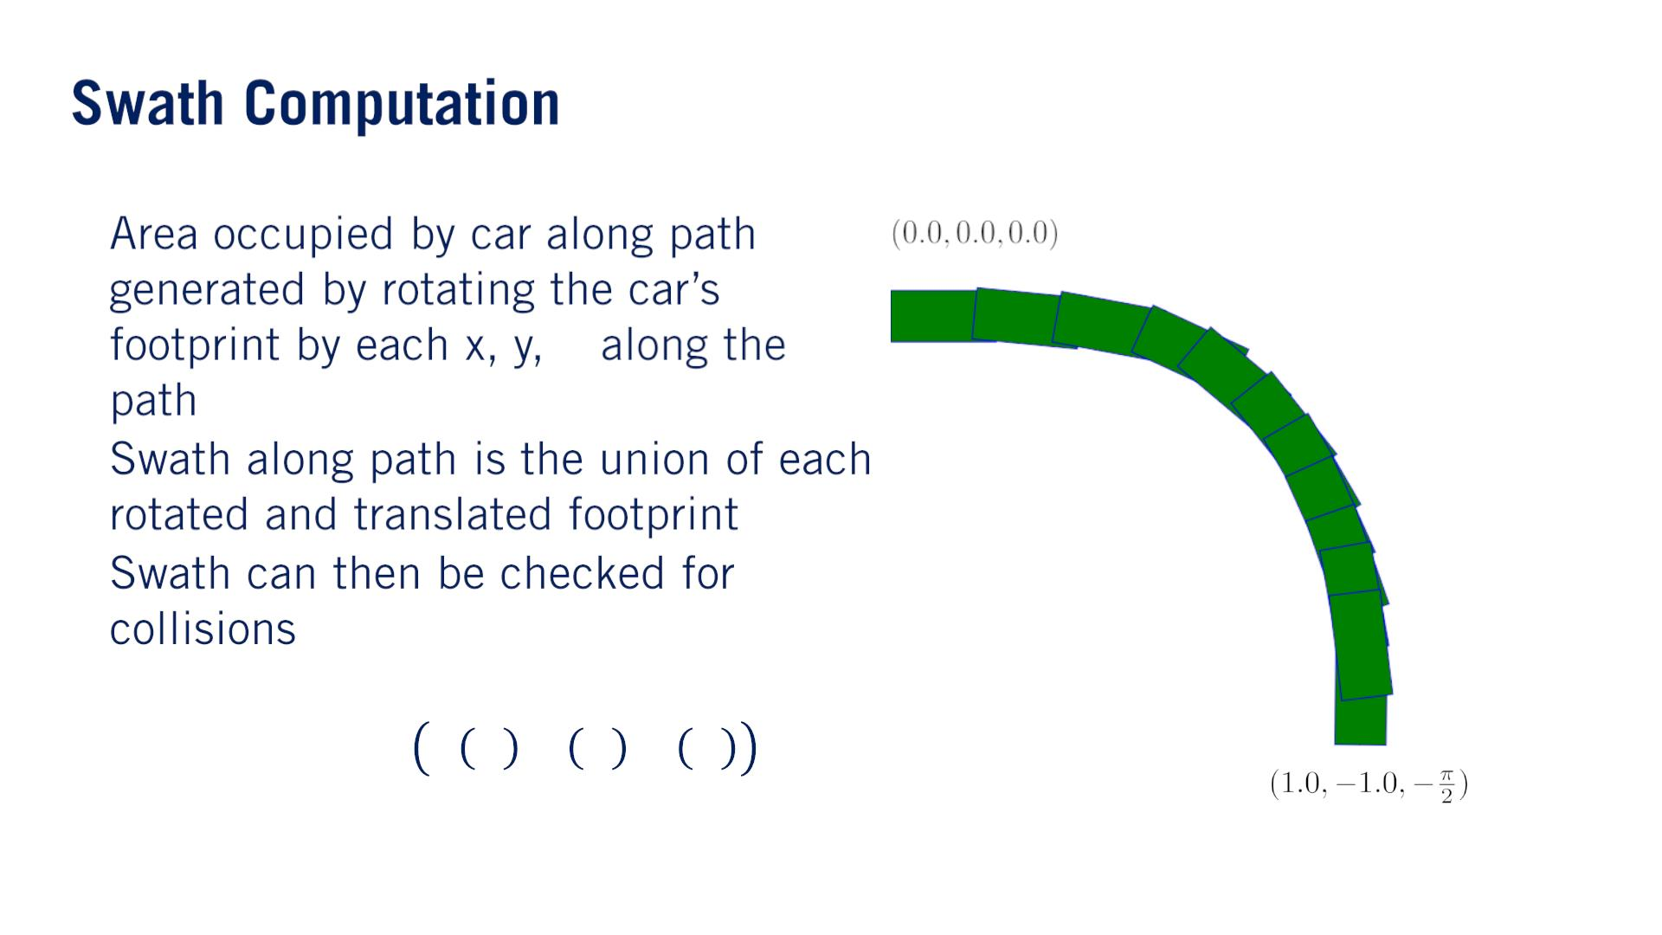
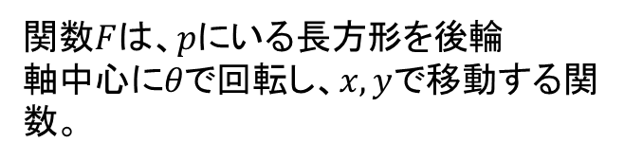
•
휃
•
•
関数$F$は、$pに$いる長方形を後輪$軸中心にθ$で回転し、$x, y$で移動する関数。

Slide 12
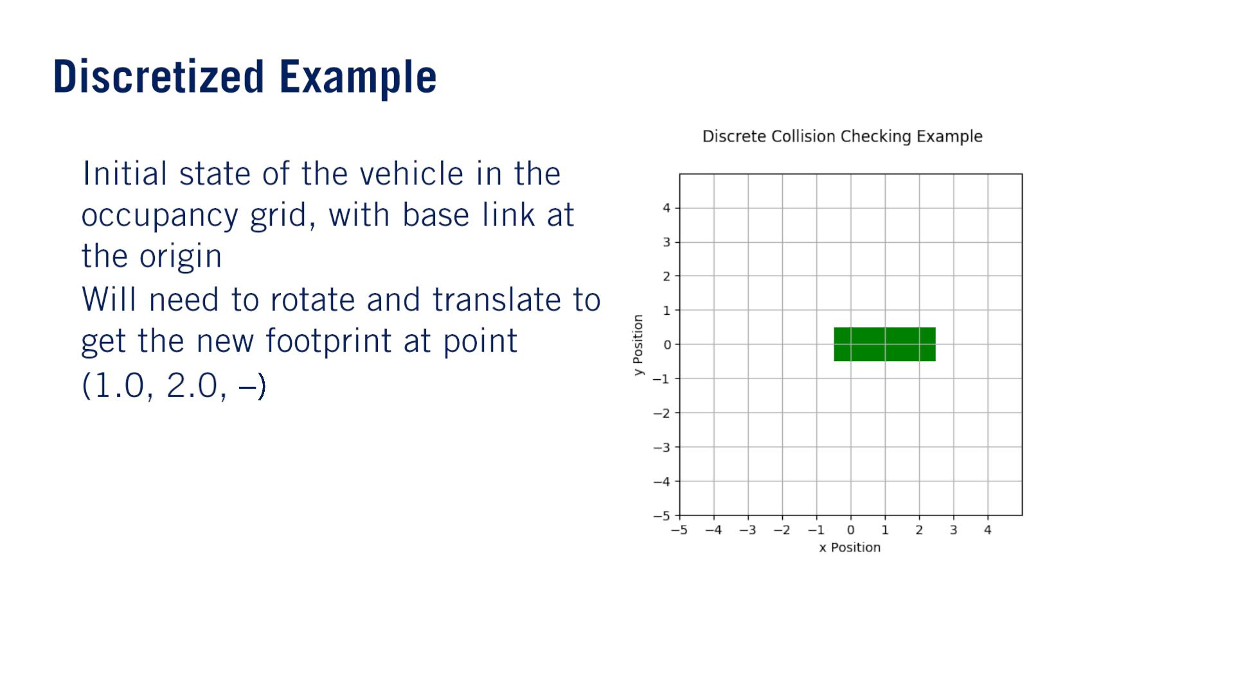
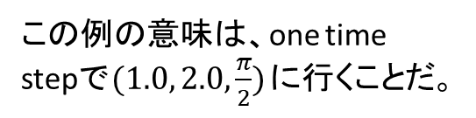
•
•
휋
2
この例の意味は、one time stepで$(1.0, 2.0,\frac{π}{2})$に行くことだ。

Slide 13
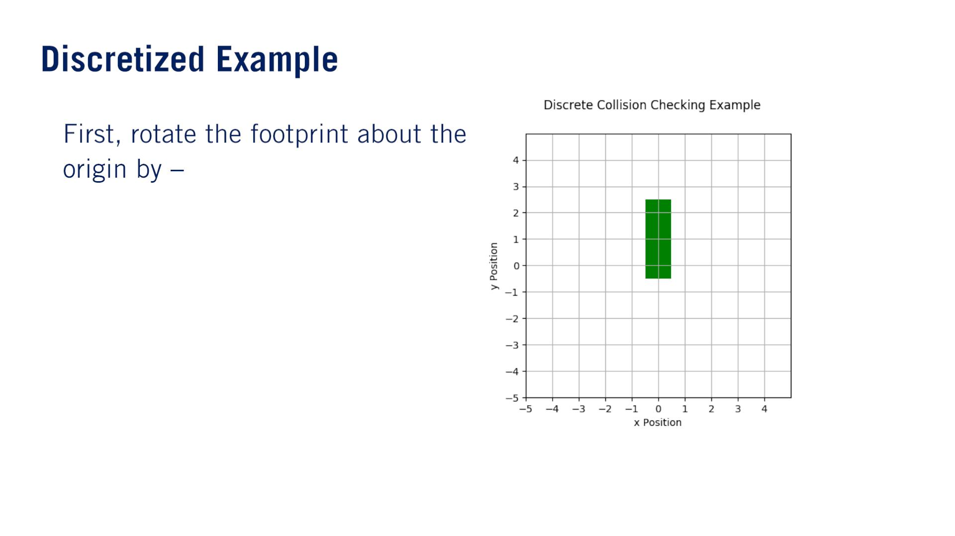
•
휋
2
回転中⼼はbase linkだそうです。

Slide 14
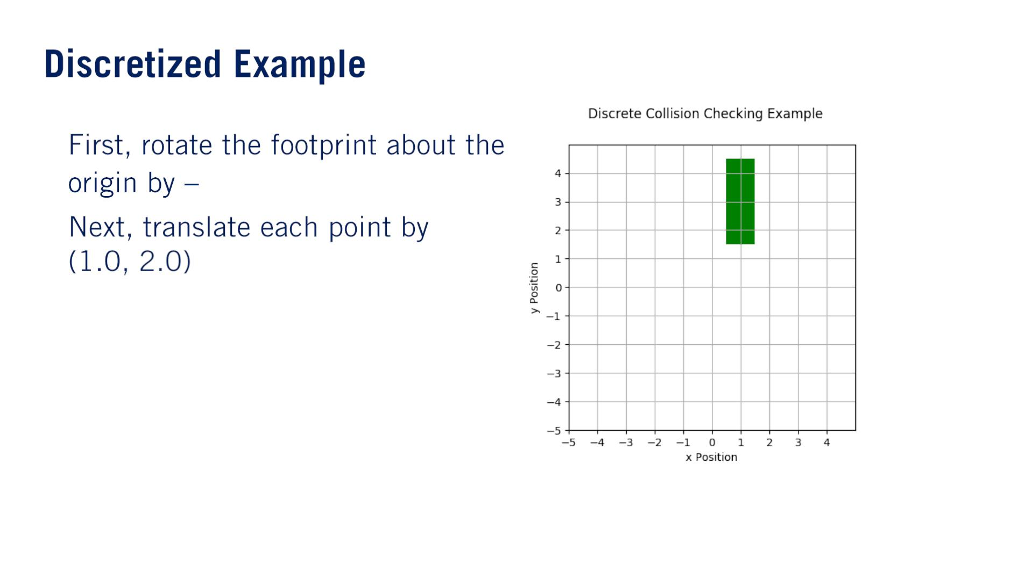
•
•
휋
2

Slide 15
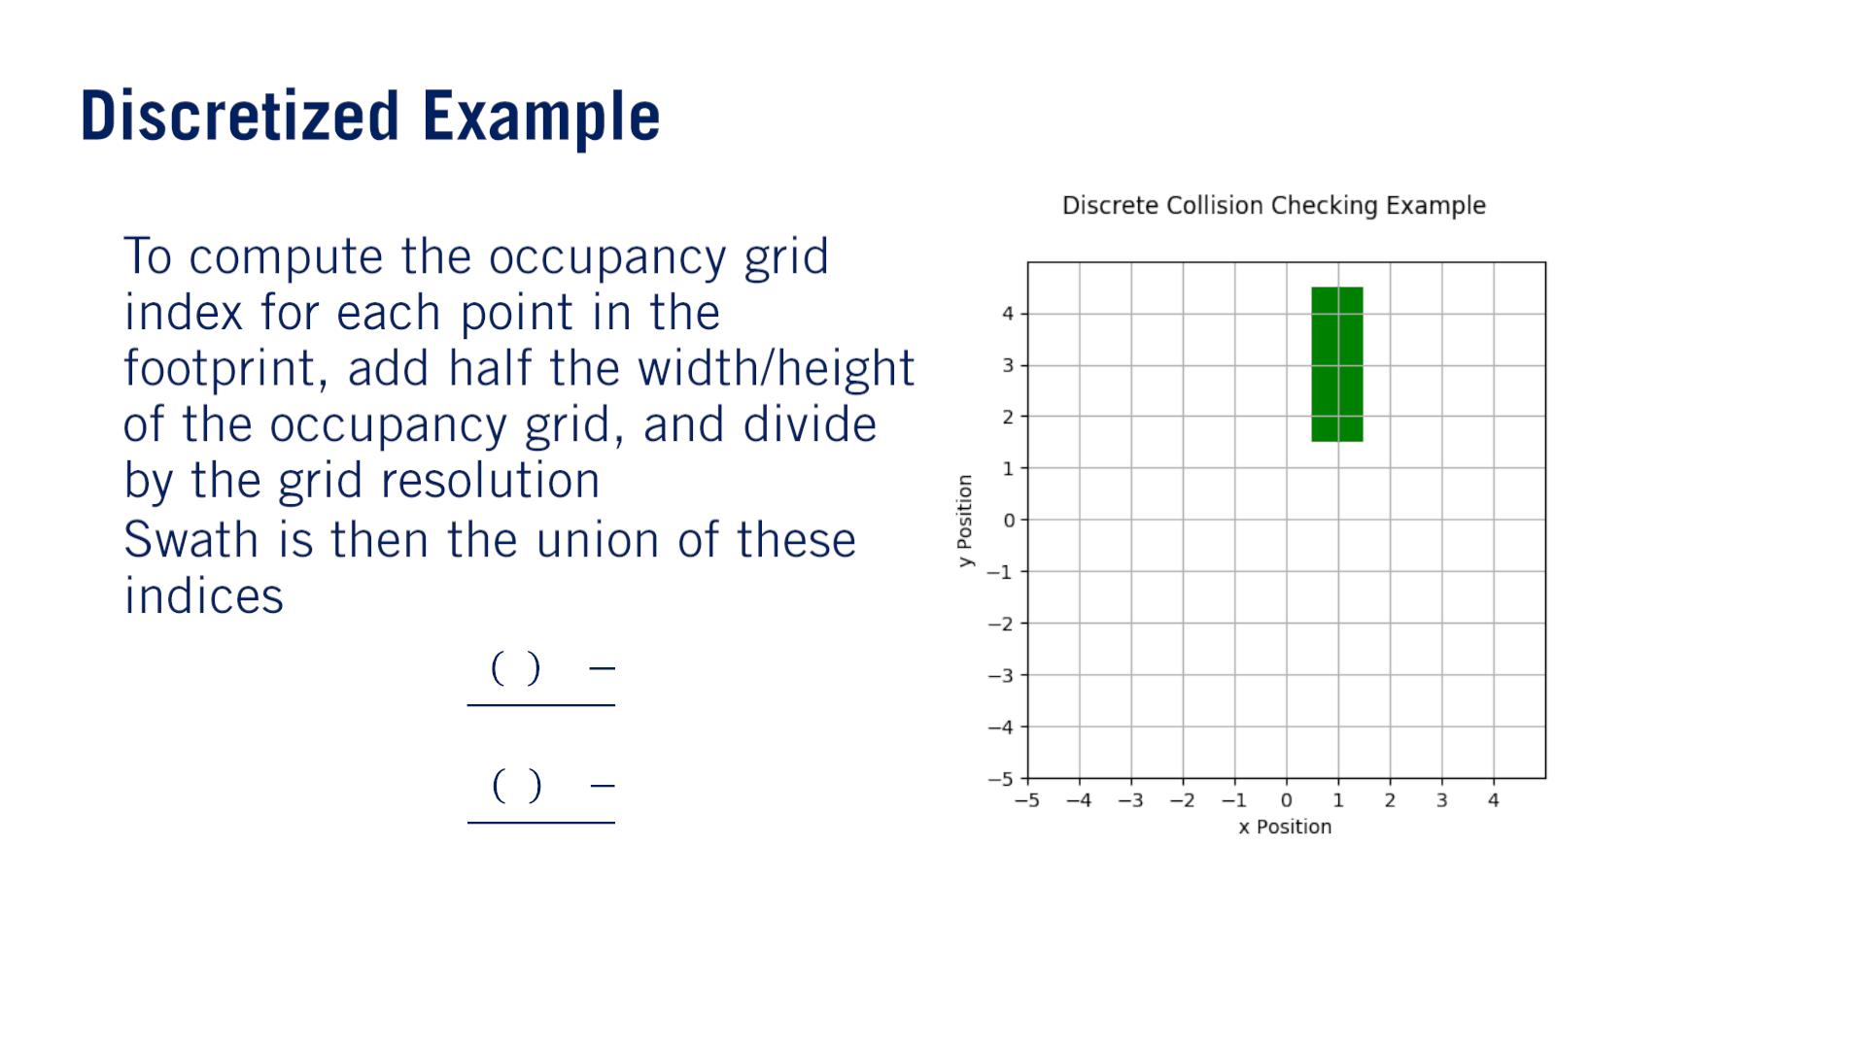
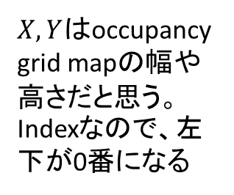
•
•
훿
푋
2
푥 푝 +
$X, Y$はoccupancy grid mapの幅や高さだと思う。Indexなので、左下が0番になる
푥_{푖} =
푦_{푖} =
훿
푌
2
푦 푝 +
훿
푆 = 푆 ∪ (푥_{푖}, 푦_{푖})

Slide 16
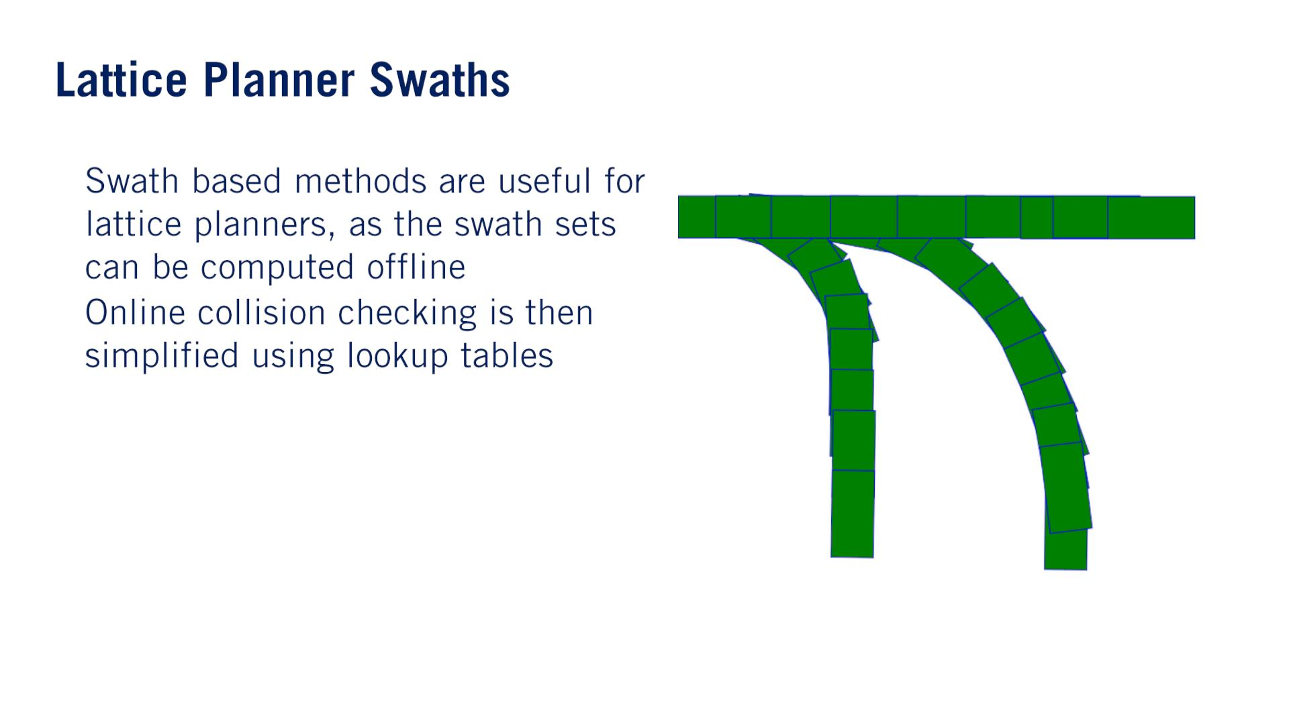
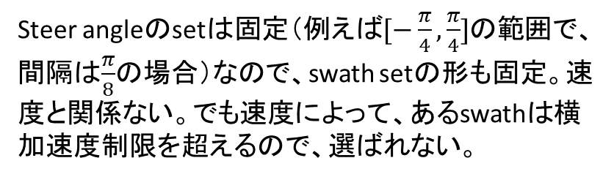
Steer angleのsetは固定（例えば$[−\frac{π}{4},\frac{π}{4}]$の範囲で、間隔は$\frac{π}{8}$の場合）なので、swath setの形も固定。速度と関係ない。でも速度によって、あるswathは横加速度制限を超えるので、選ばれない。
•
•

Slide 17
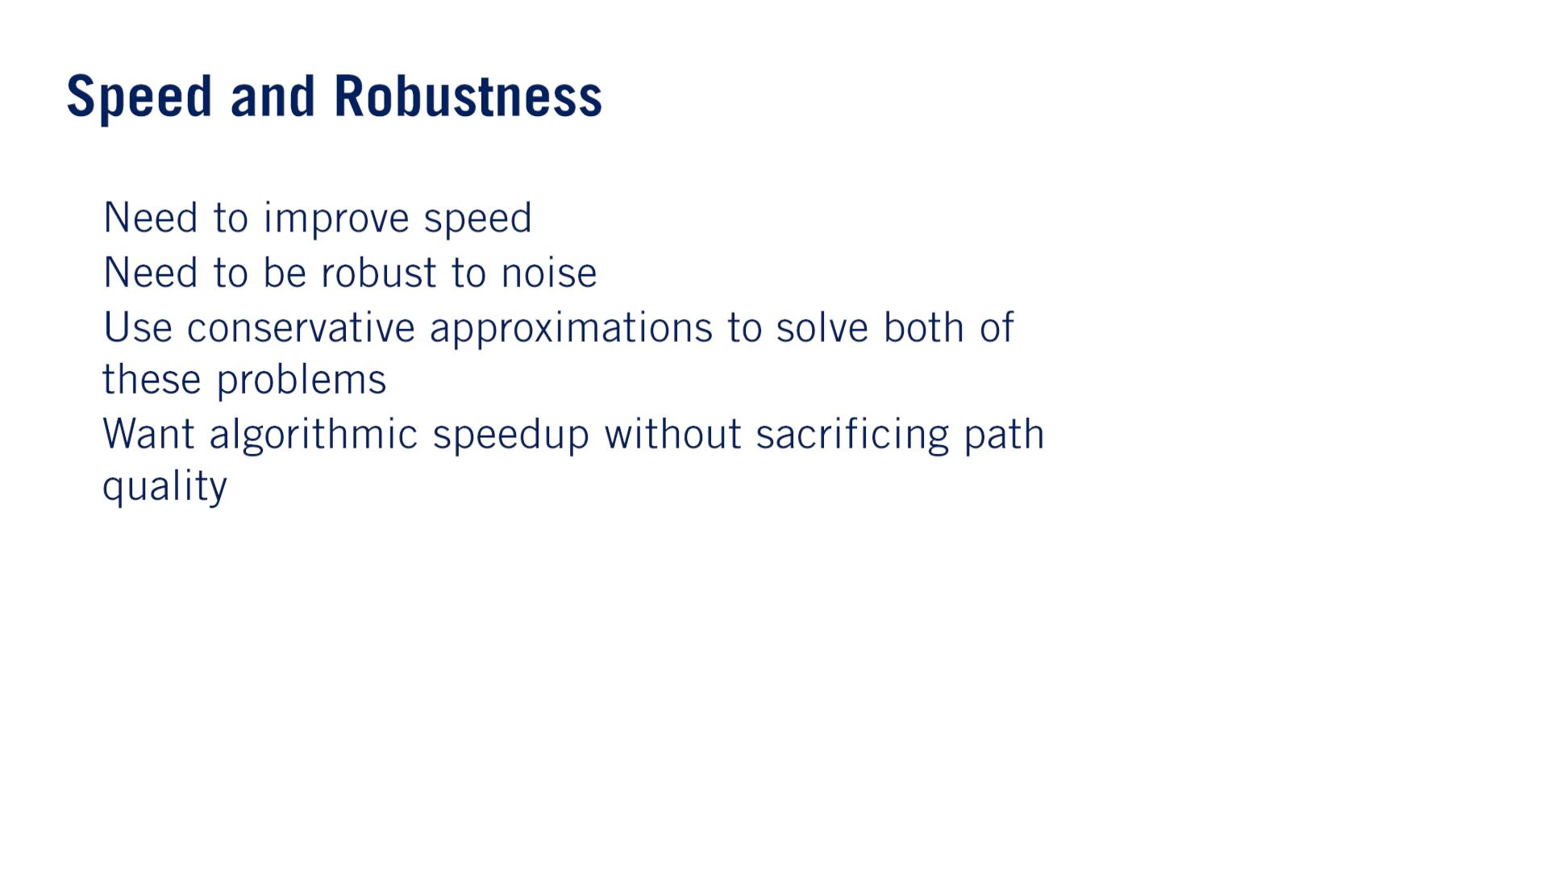
•
•
•
•

Slide 18
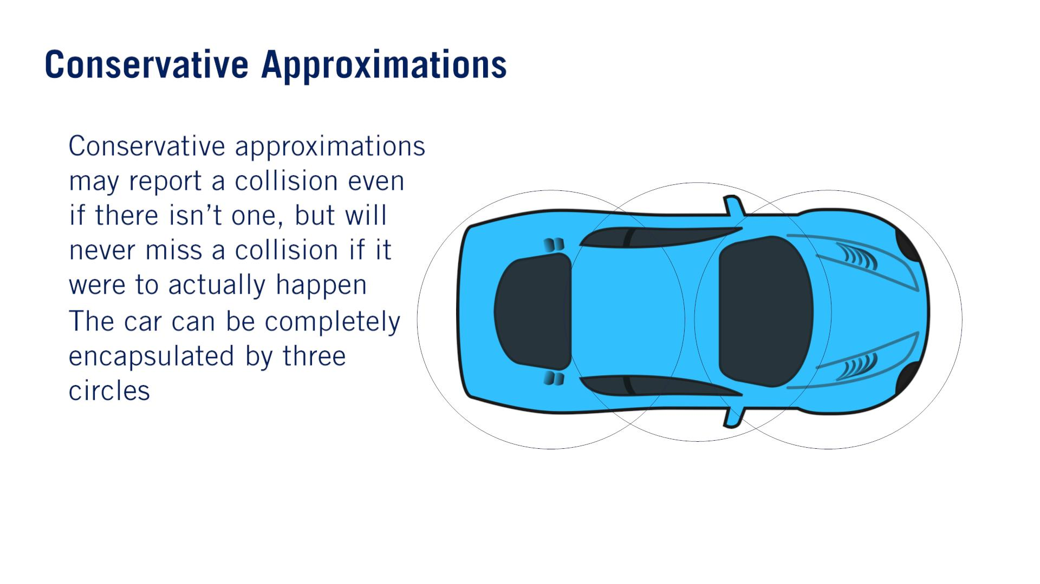
•
•

Slide 19
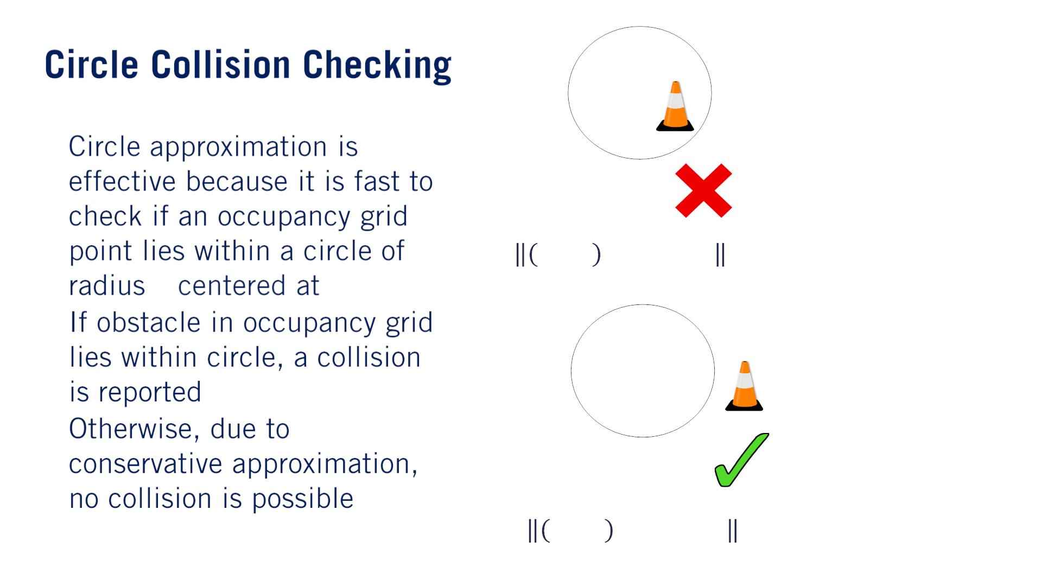
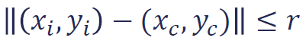
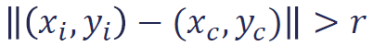
•
Conservative approximationの課題：They may eliminate all feasible collision-free paths from a problem even though a path exists or eliminate safe passages through narrow openings.
This can cause the planner to get stuck（動けなくなる） when it shouldn’t or can cause the planner to compute a much more circuitous（遠回りの） route than is necessary.
푟
(푥 , 푦 )
푐 푐
•
•
衝突検知について、ポリゴンの交差の計算より、サークルベースの計算が簡単だと思う

Slide 20
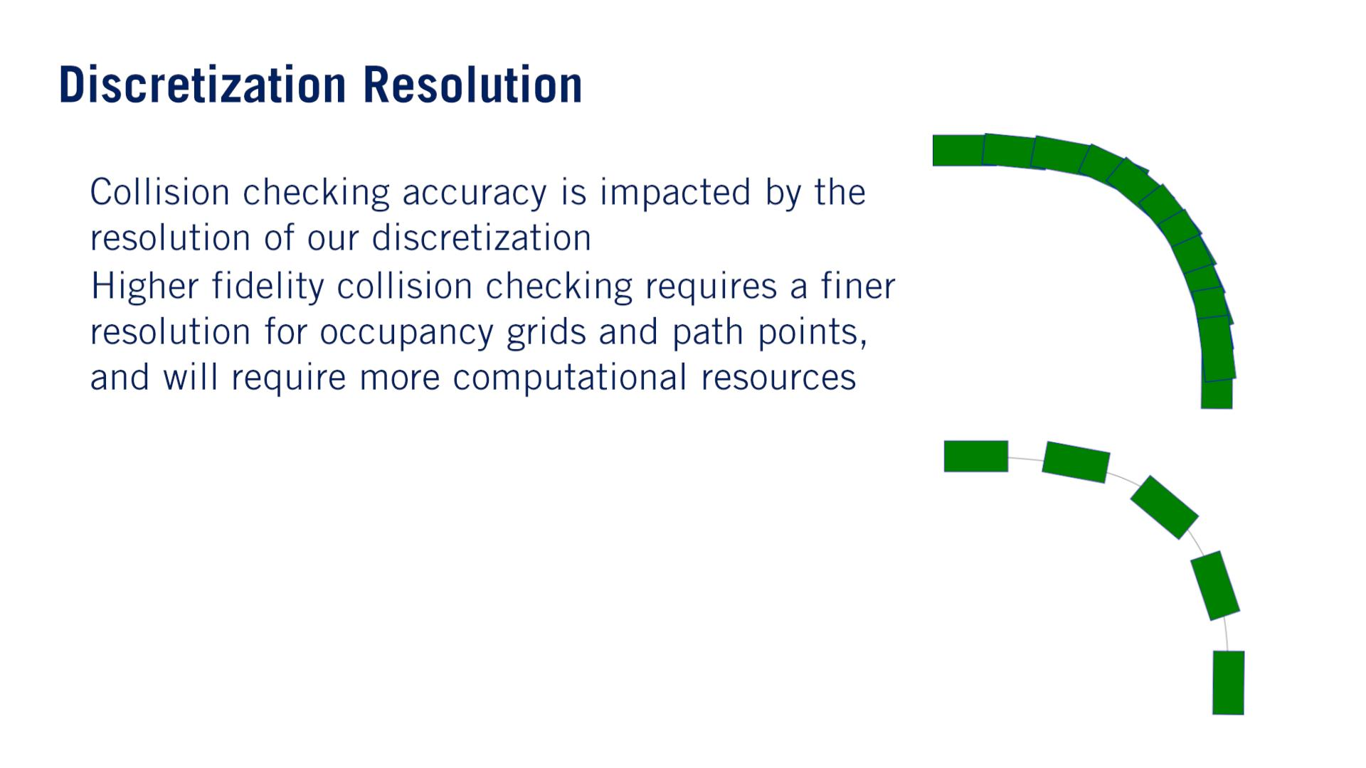
•
•

Slide 21
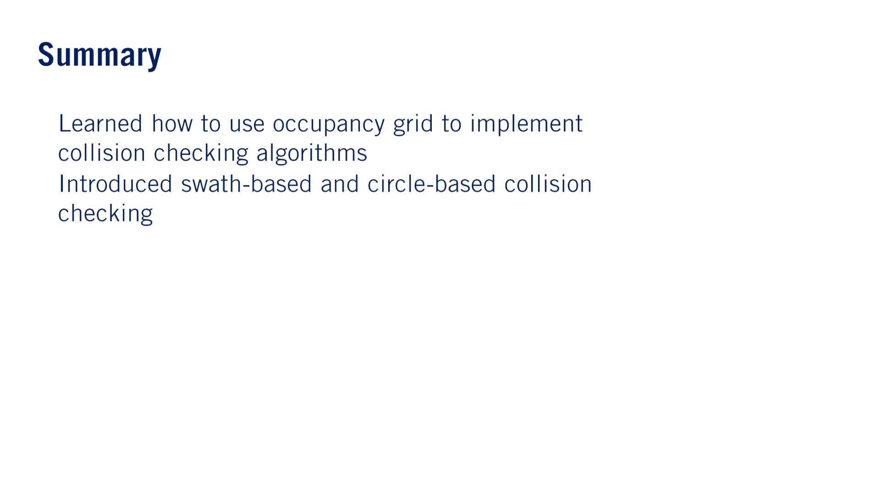
•
•
Performing quick and efficient collision checking especially with dynamic obstacles is currently an area of active research.
単語
Prohibitive: If the cost of something is prohibitive, it is so high that many people cannot afford it.
Amount to: If you say that one thing amounts to something else, you consider the first thing to be the same as the second thing.
Circuitous: A circuitous route is long and complicated rather than simple and direct.

Slide 22


Slide 23
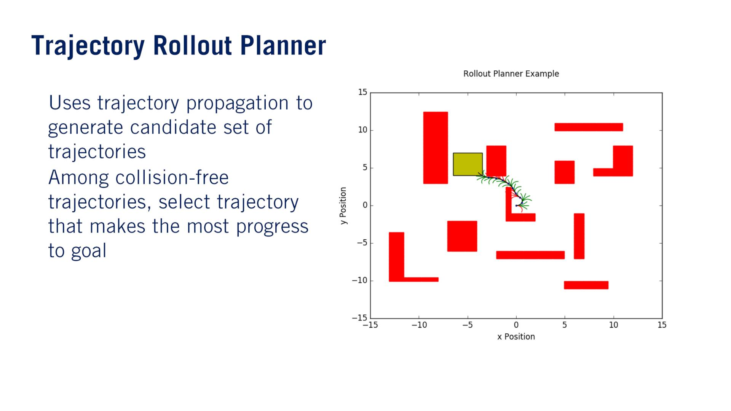
伸ばす
•
•
By performing this repeatedly, we end up with a receding horizon planner that reacts to the environment while making steady progress towards the goal.

Slide 24
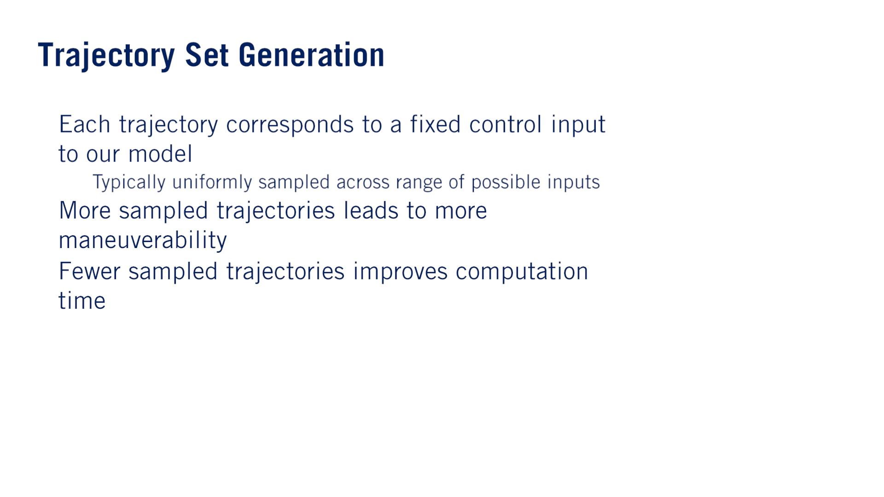
•
For multiple steps over a constant time horizon（計画期間）.
o
•
•
Each additional trajectory will need to be generated, checked for collisions, and scored.

Slide 25
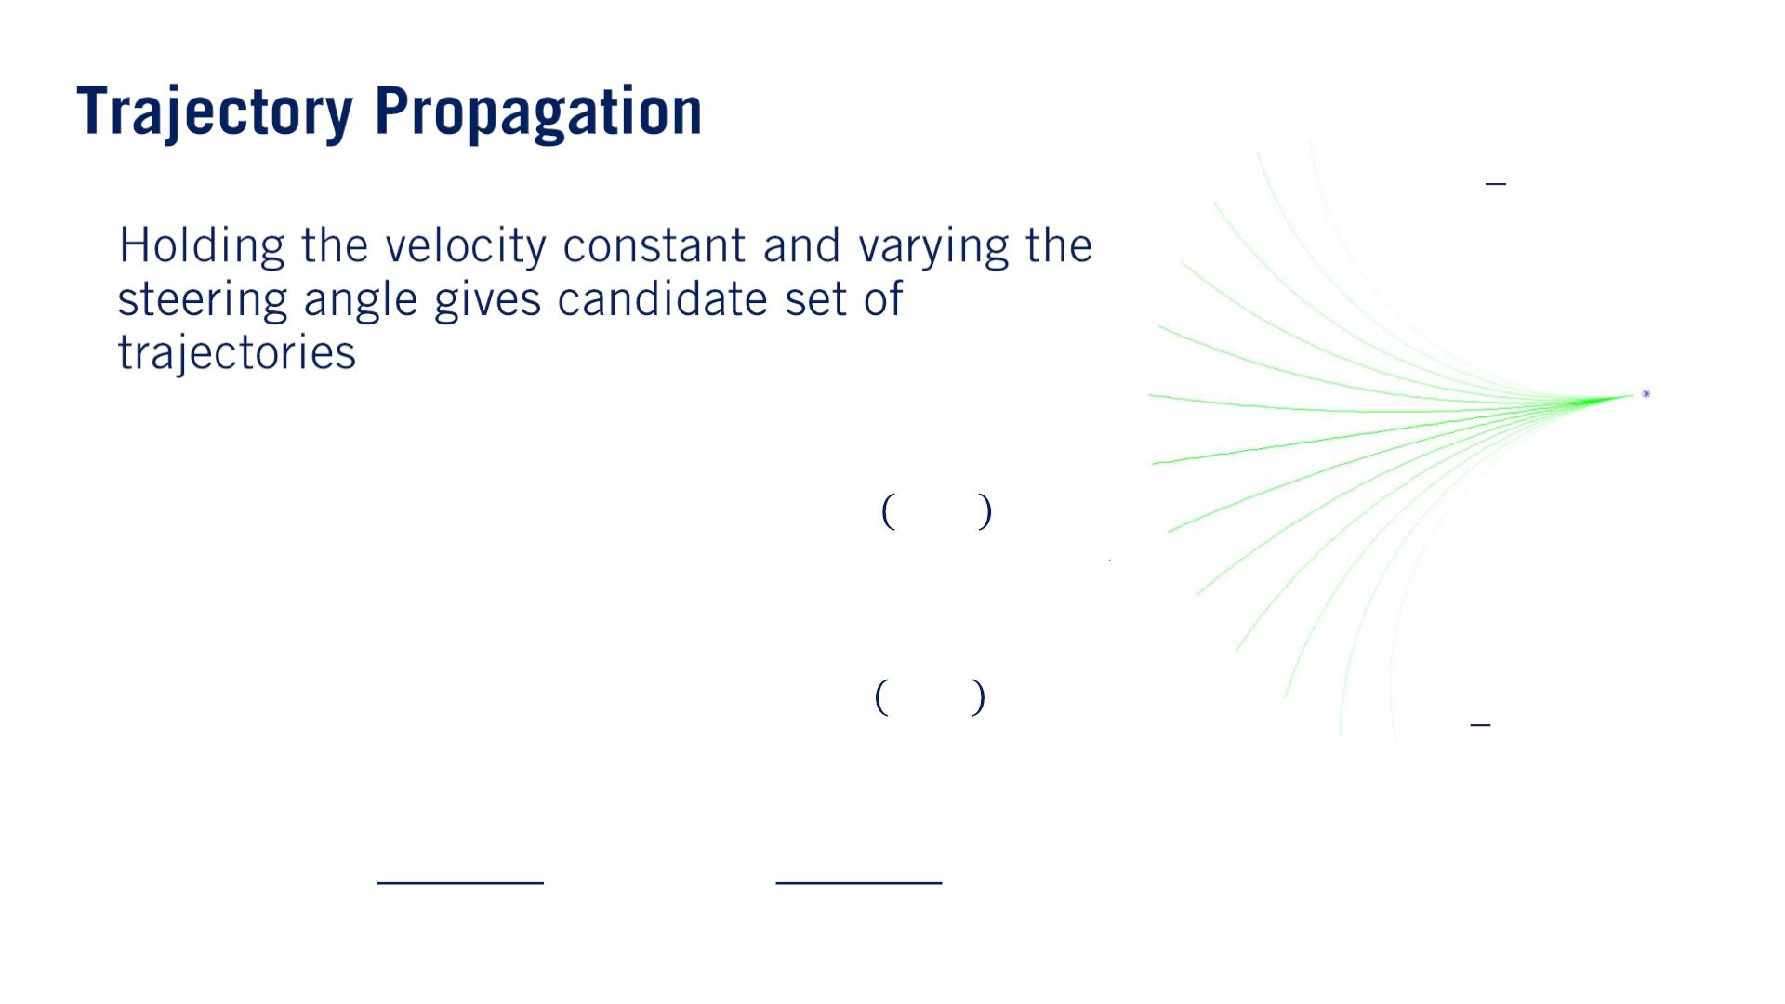
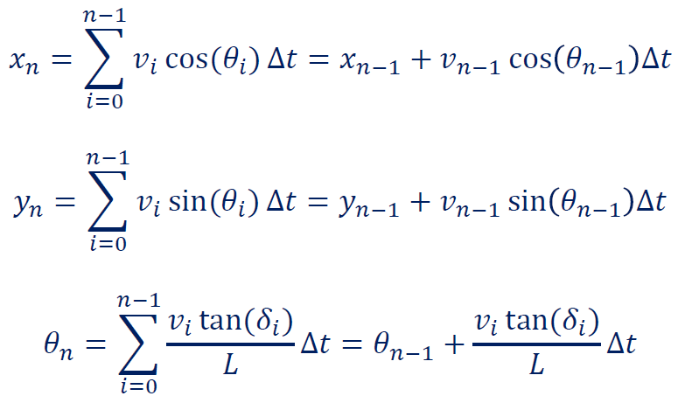
휋
4
훿 = −
•
휋
훿 =
4
kinematic equationsを使う。
We now have a set of arcs as our candidate trajectories.

Slide 26
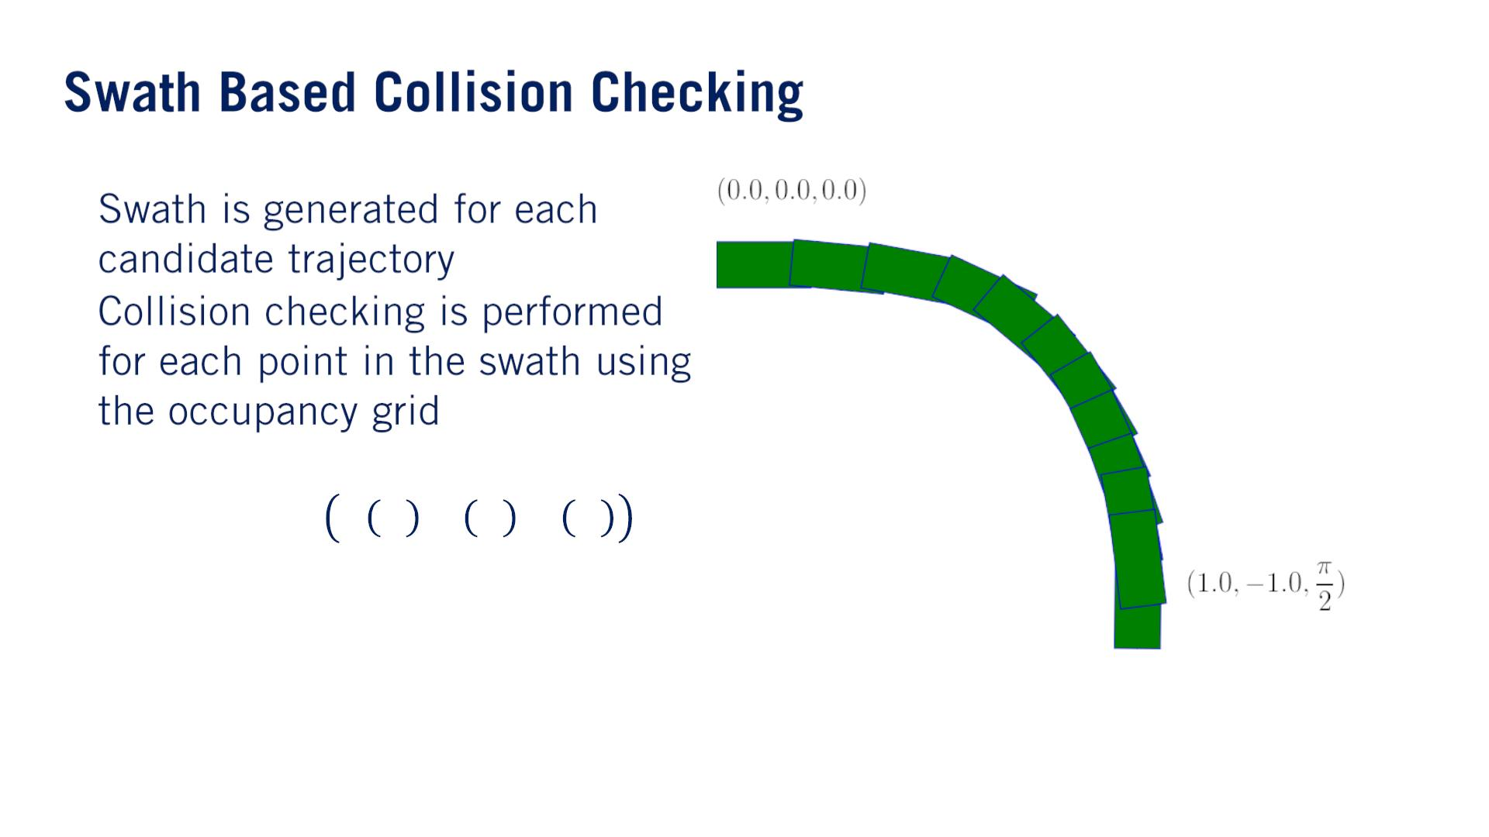
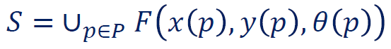
By sweeping the body of the robot along the path, and taking the union of all the footprints at each time step of a given trajectory.
•
•
The footprint of the car will correspond to a set of indices in the occupancy grid.
So each rotated and translated point along the path will also correspond to different indices in the occupancy grid.
Iterating through each point in the swath set and checking the associated index in the occupancy grid for an obstacle.
If any point in the swath is occupied, then that trajectory contains a collision.

Slide 27
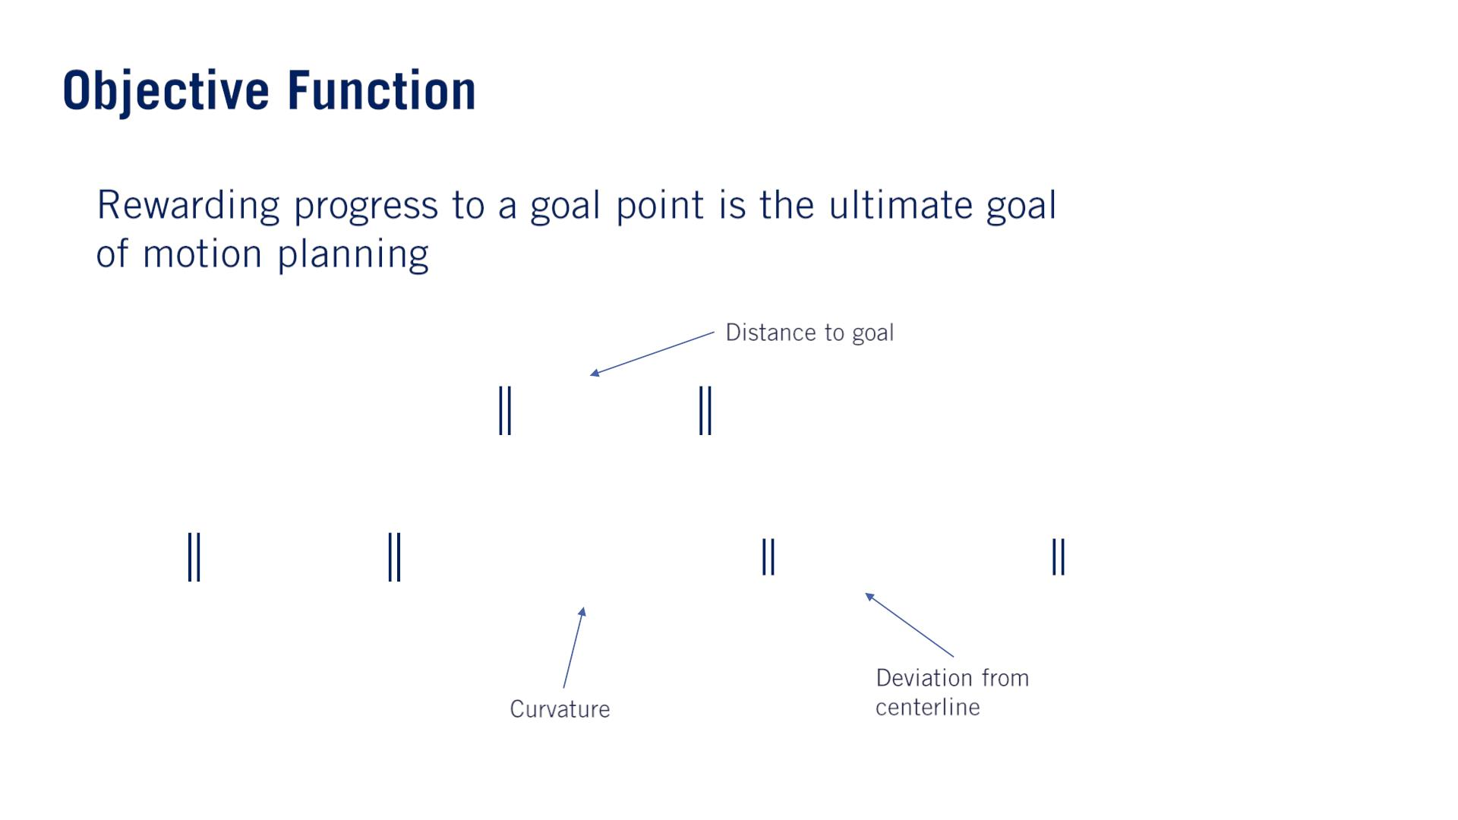
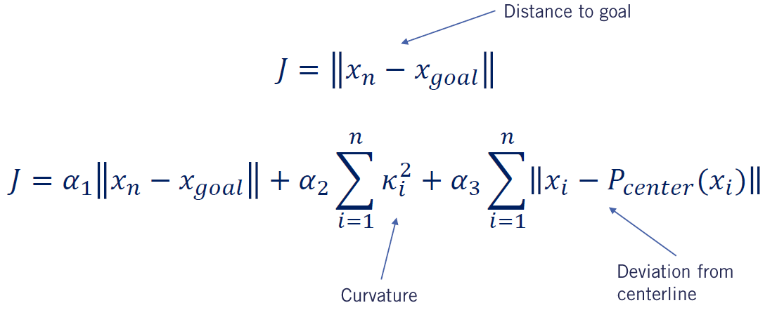
•
Sometimes, we also want to reward paths that maximize the distance to the nearest obstacle, to maximize the flexibility of feasible paths available to future time steps in the planner.

Slide 28
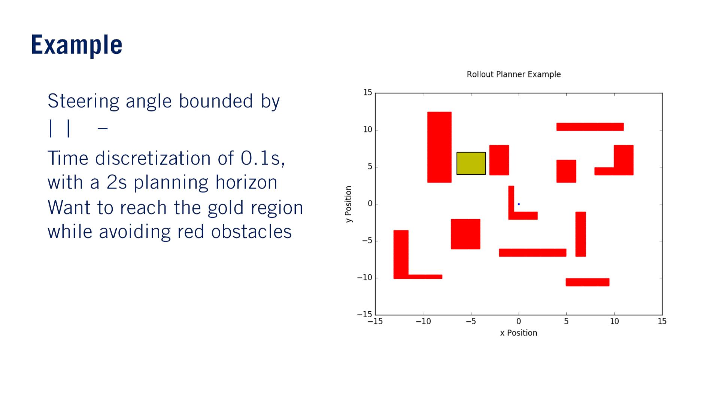
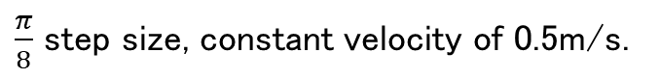
•
휋
4
$\frac{π}{8}$ step size, constant velocity of 0.5m/s.
훿 ≤
•
•

Slide 29
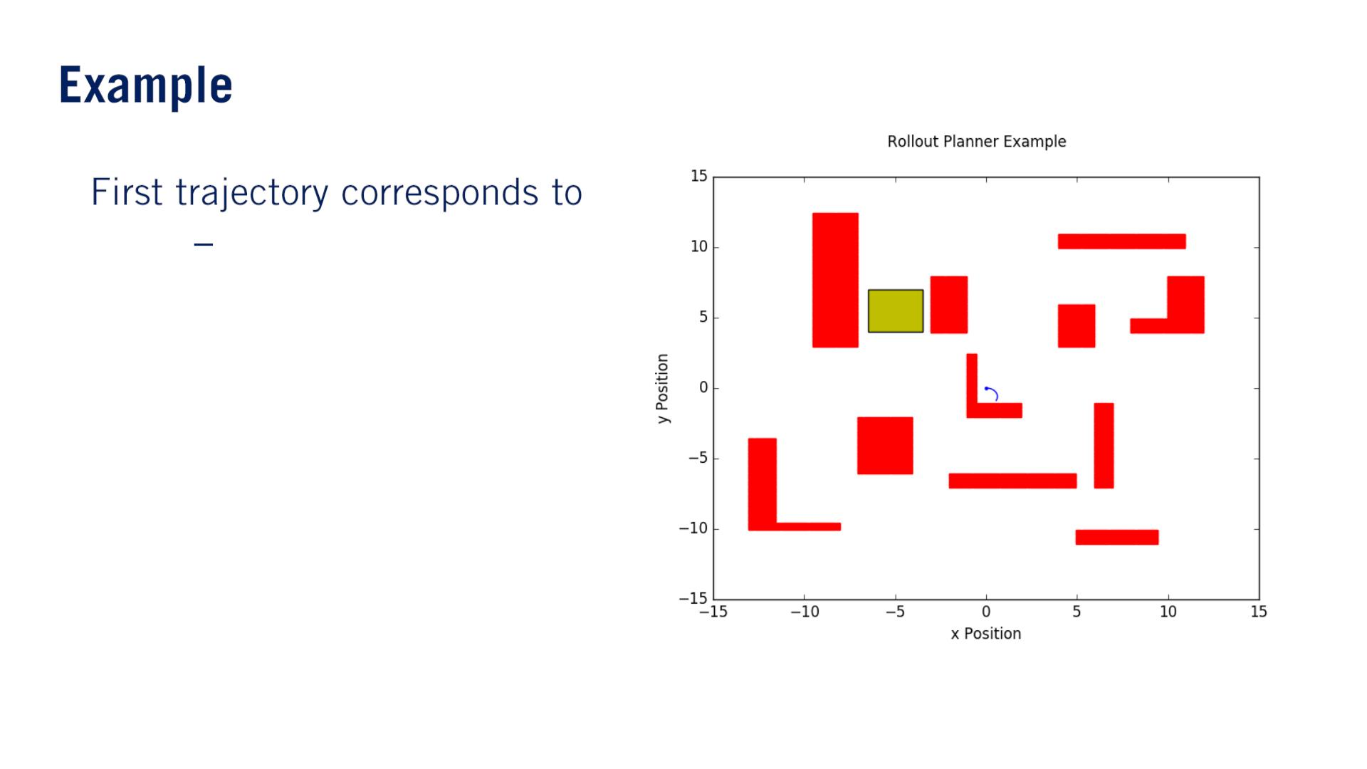
•
휋
4
δ = −

Slide 30

•
휋
δ = −
8

Slide 31
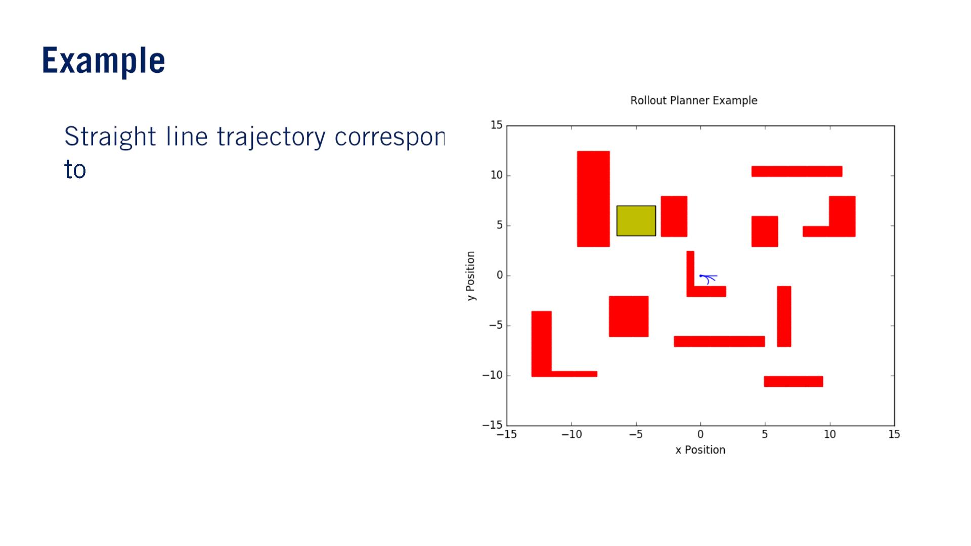
•
δ = 0

Slide 32
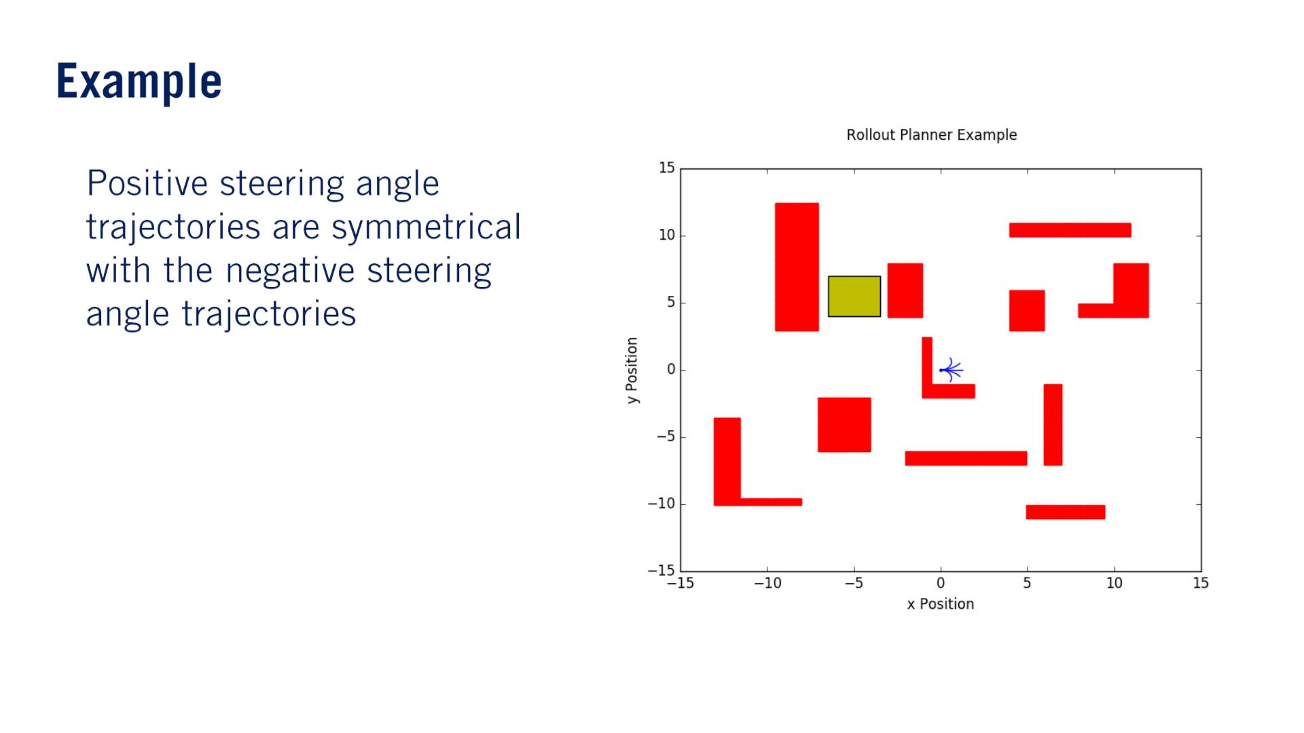
•

Slide 33
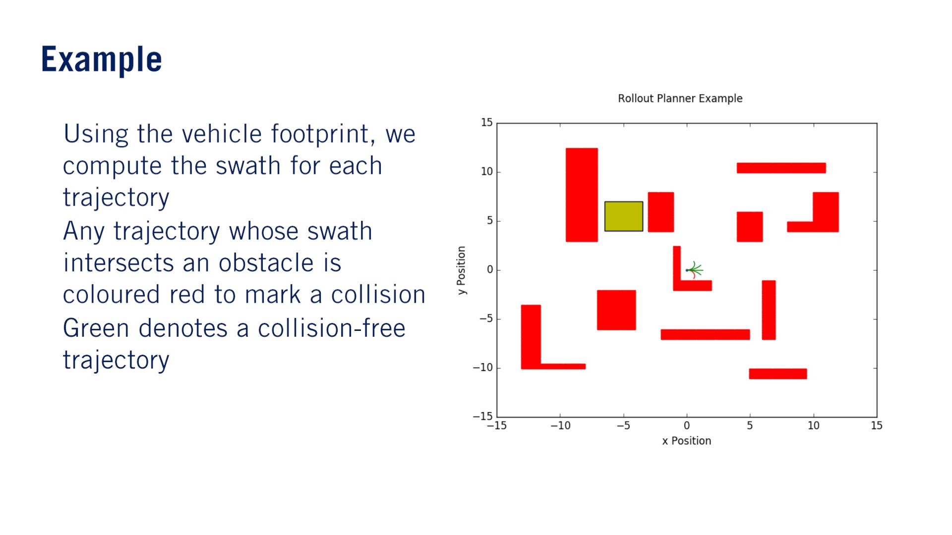
•
•
•

Slide 34
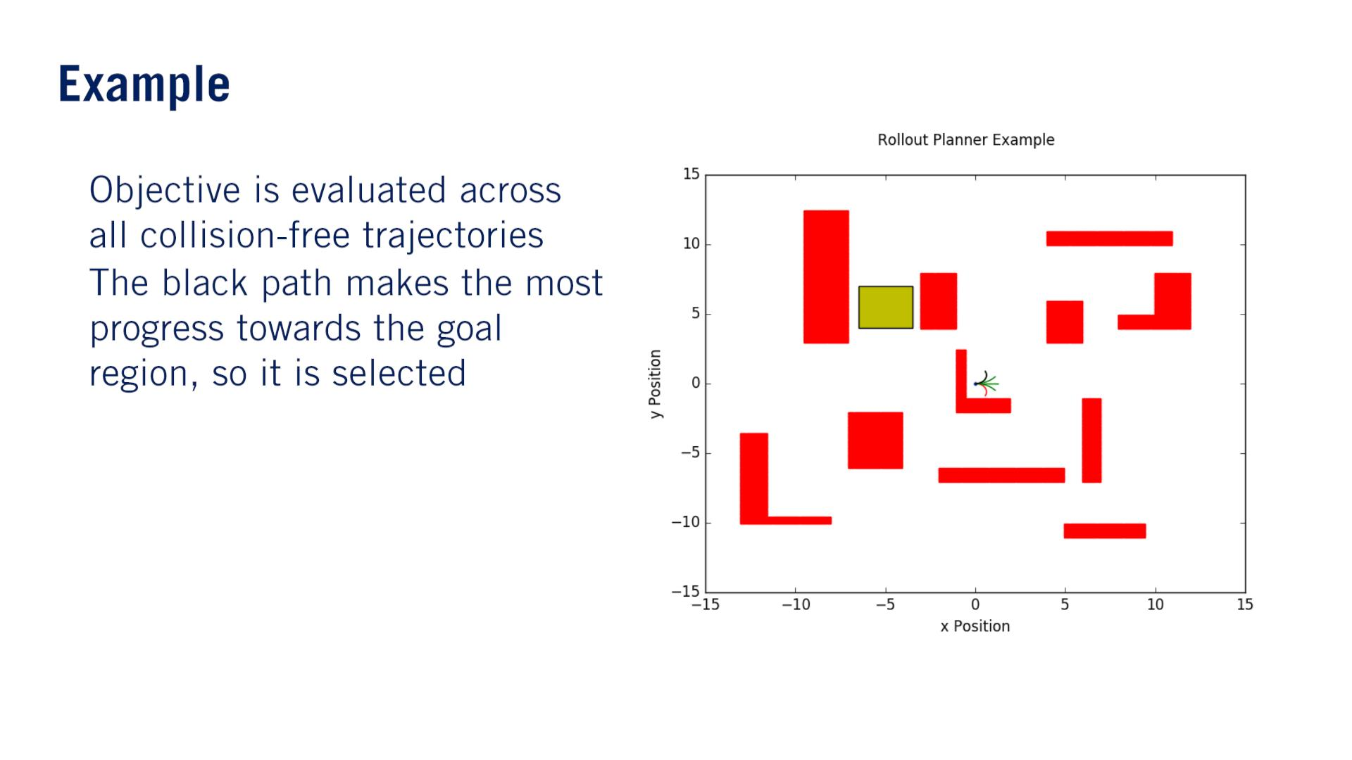
•
•

Slide 35
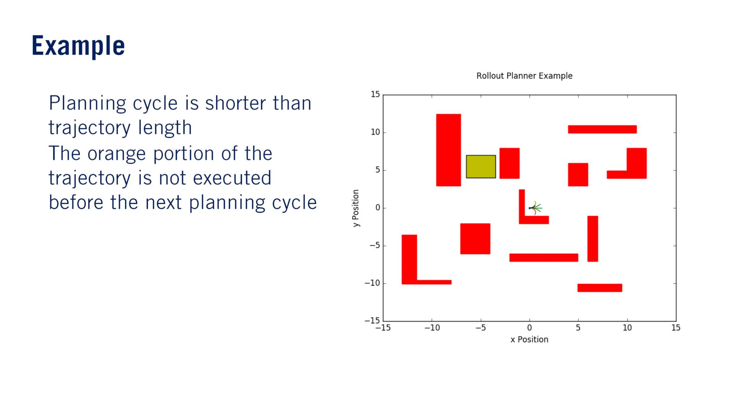
The vehicle will execute only the first few points of the cycle.
The exact number depends on the planning frequency and our planning horizon will be shifted forward depending on our progress.
•
•

Slide 36
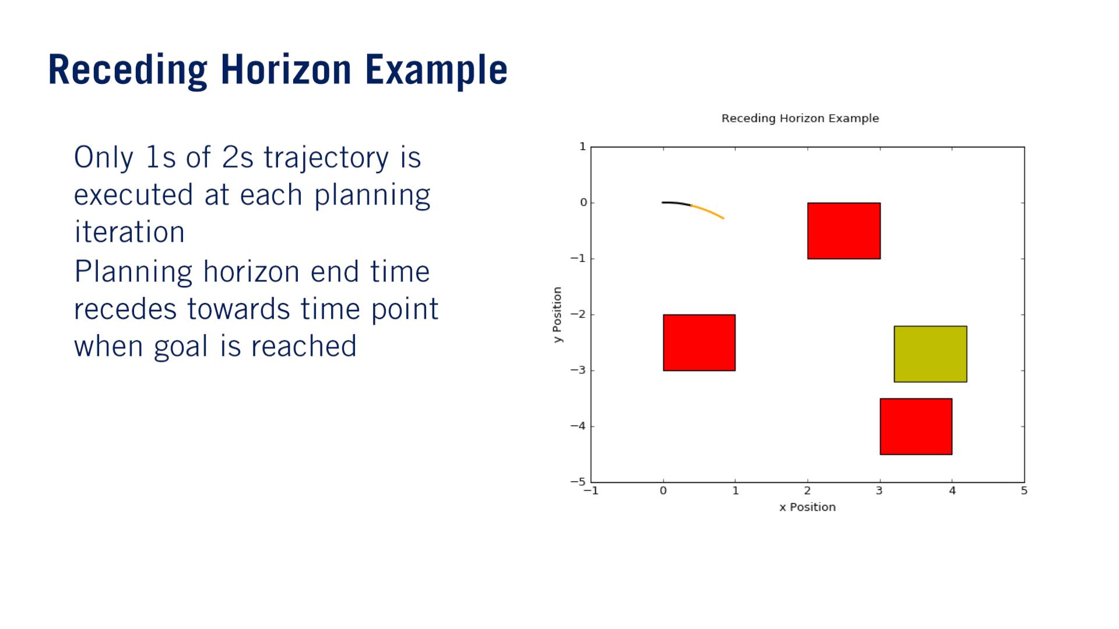
後退する
•
•

Slide 37

•
•

Slide 38
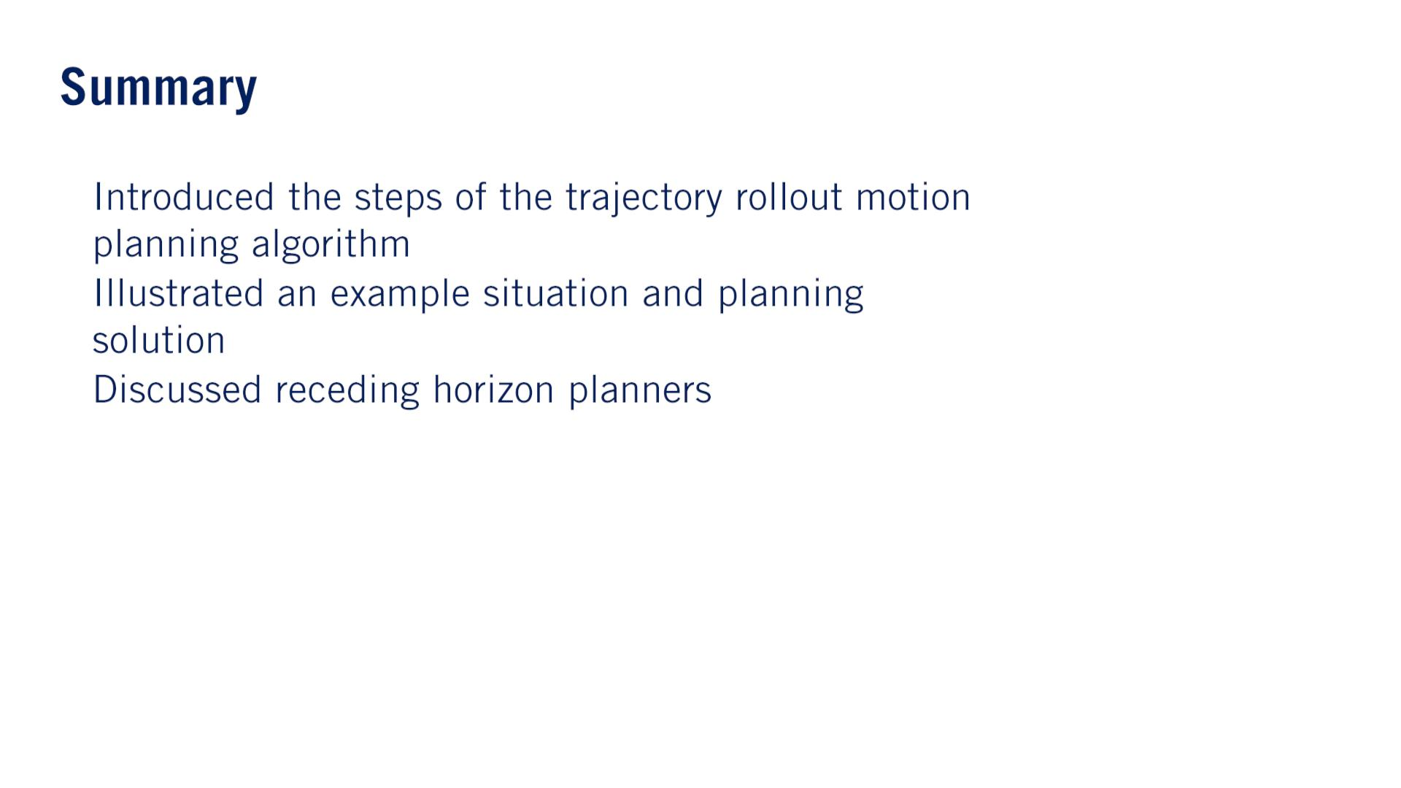
•
•
•

Slide 39


Slide 40
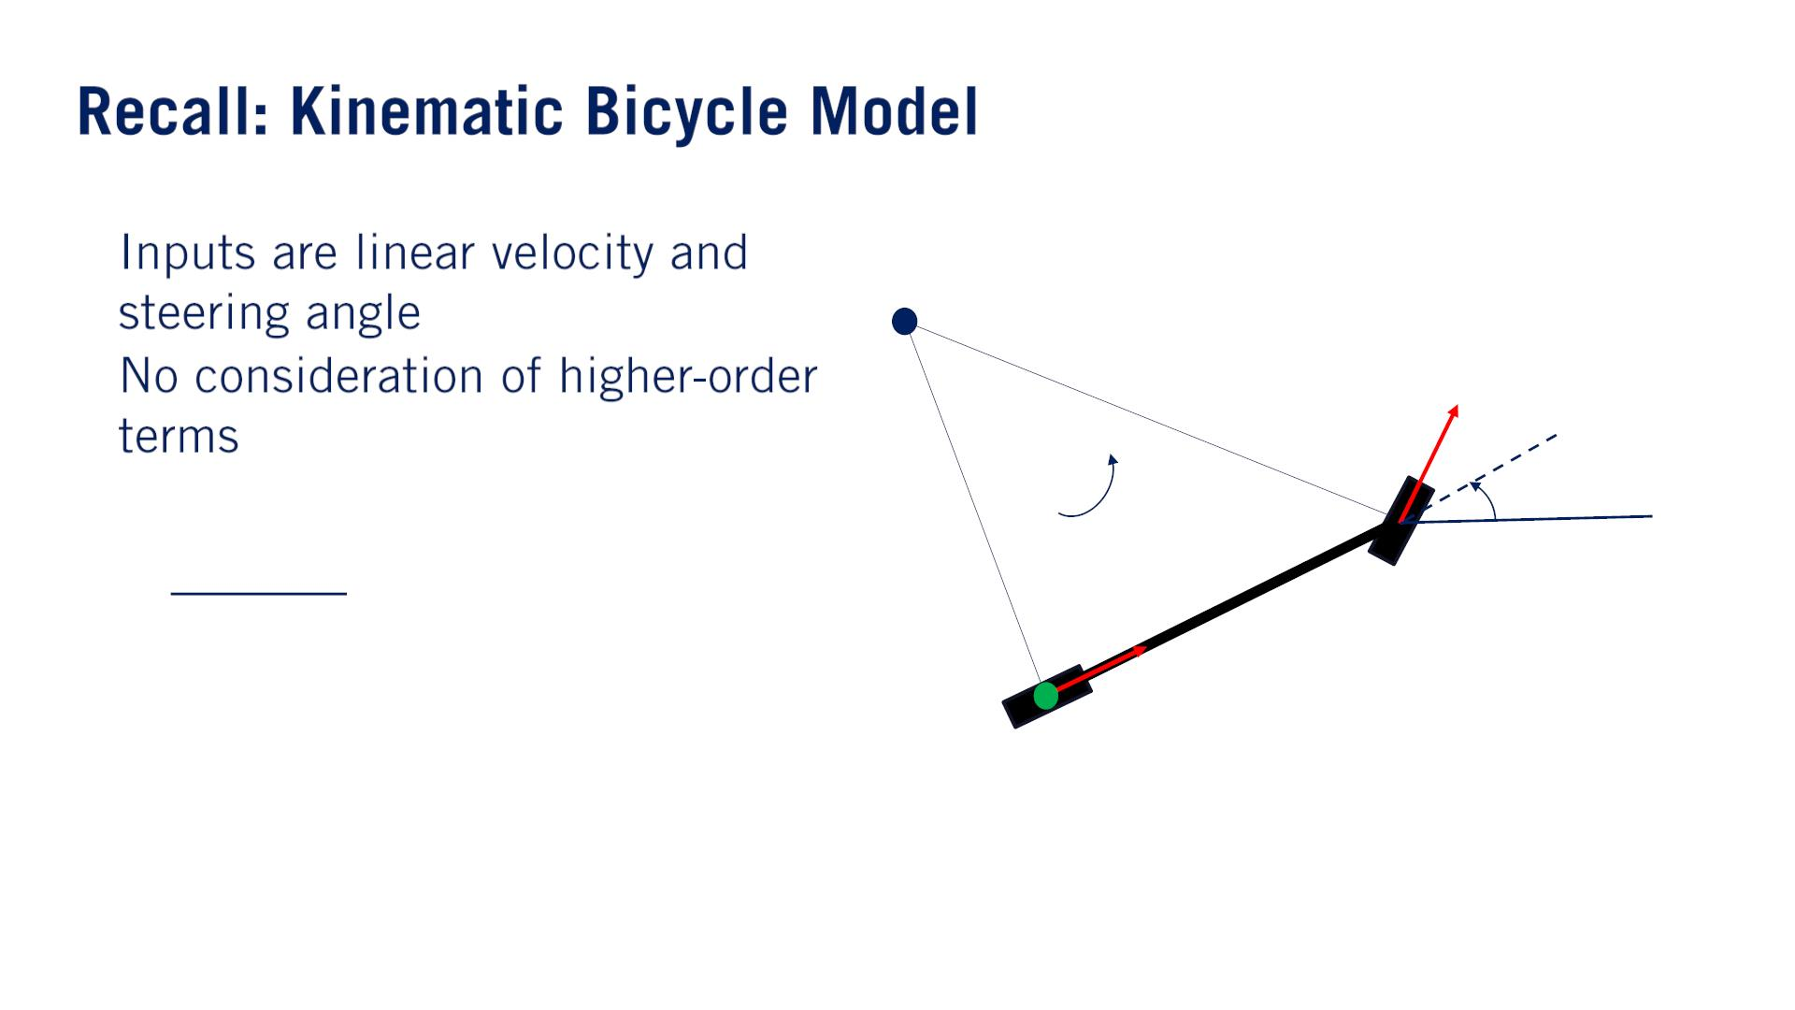

These higher-order terms are what cause discomfort for passengers in the car, so we should try to address this in our kinematic model.
•
•
ICR
훿
such as acceleration or jerk.
푣
훿
푅
휔
휃
푣
퐿

Slide 41


•
•
ICR
훿
푣
훿
푅
휔
휃
푣
퐿

Slide 42


•
•
•
加速度の制限による速度変化量の制約はvelocity profileの生成にも考えないといけない。

Slide 43


•
푣 = 1 푚Τ푠
훿₁ =
휋
Δ푡 = 1 푠
8
훿 = −
푚푖푛
휋
4
퐿 = 1 푚
휋
4
훿 =
푚푎푥

Slide 44


Slide 45

•
•

Slide 46

•
•

